Slide 1
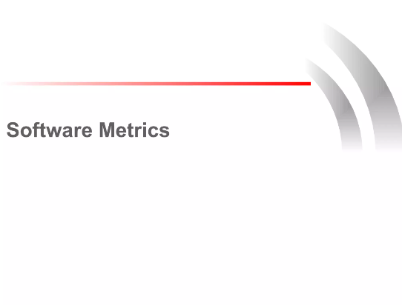

Slide 2
What are Software Metrics?
Software Metrics are the measure of the characteristics of the software products and software development processes. These features are quantifiable. While measuring the software products the metrics look for-
Size
Design Features
Complexity
Performance
Quality

Slide 3
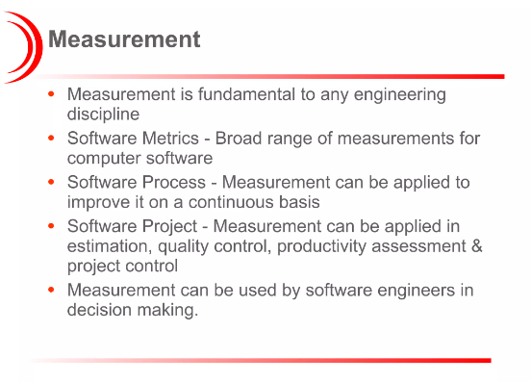

Slide 4
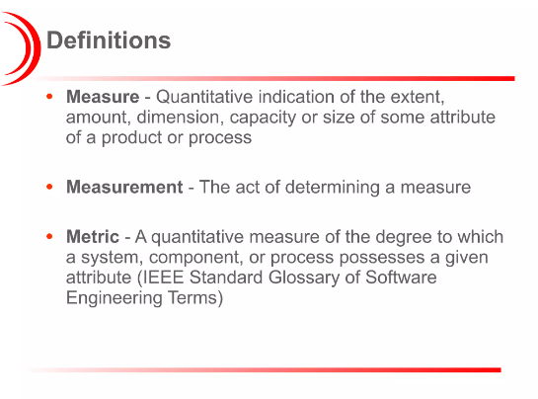

Slide 5
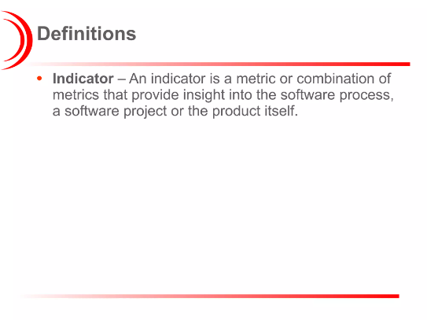

Slide 6
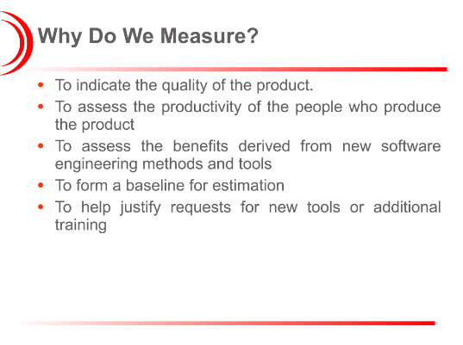

Slide 7
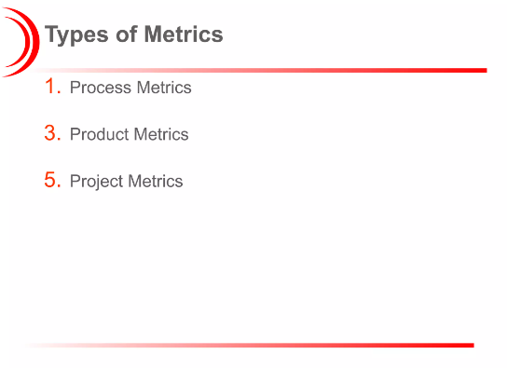

Slide 8
Guidelines for Appropriate Use of Software Metrics
The whole software development team should collectively design the software metrics for better and efficient work. An ideal software metric should posses the following features:
Simple and Reliable
Consistent
Unambiguous
Uniform units for measurement
Easy calibration
Cost Effective
Accurate

Slide 9
But in order to obtain the best results, we must understand how to use these software metrics. Given below are the guidelines for appropriate use of Software Metrics.
Guidelines for appropriate use of software matrices
Link software metrics to goal
Track trends not a Numbers
Set a shorter measurement periods
Stop using software metrics that do not lead to change

Slide 10
Link Software Metrics to Goals
The software metrics should be linked to the goals of the software development team to unite the purpose. If the focus becomes common then work will be efficient.
Reduction in the line of codes.
Reduction in the bugs reported.
Increasing the iterations
Speeding up tasks
If metrics become targets then developers will find it easier to improve the overall use of software and user experience.
While the overall goals of the enterprise are being discussed by the management, it is necessary to involve the software development team to choose the relevant software metrics. These metrics will later on derive the overall performance of the enterprise.

Slide 11
Track Numbers not Trends
Software Metrics are useful for management as they provide numeric data in place of complex data. These simple numbers are easier to compare with other standards. Whenever the metric target is met, developers know it is a success.
On the other hand when it is not met, it means somewhere something is missing and better work must be done for the next turn. When we use metrics we measure trends. Single data set is of not much relevance.
Trends show how much we have progressed since before. If the target is not achieved it is a failure or vice-versa. But if we measure trends then we can understand what to do to make it a success. We can understand the reasons for failures.

Slide 12
Set a Shorter Measurement Period
Software team always wants to get work done instead of waiting and setting targets or measuring them. Doing is more important. Therefore, using an approach in which repeated target setting is not required is better and less worrisome for the team.
Only when the final outcome is ready, the team should check if it is a success or a failure. If the whole measurement period is broken into smaller segments then the team can monitor the metrics better.
They can analyze the trends and keep a check on the progress. The broken segments will offer better data points to analyze the outcome and it will be better for achieving the goals as well.

Slide 13
Stop using Metrics that do not lead to Change
It is a known fact that doing something repeatedly when the end result will be a failure is a waste of time. In fact it is called Insanity. But making relevant adjustments that can change the outcome is what we need.
But when we talk about software metrics, doing the exact same thing repeatedly is called managing metrics. Why do developers do it? Why do they keep repeating the same thing again and again?
The answer is that developers are focused on those software metrics that do not measure the goals. There are certain metrics which are irrelevant for measuring the goals or objectives or workflow.
Management and the developers must focus on those software metrics that will help them achieve the goals and bring them closer towards success.

